Slide 1



Sprocket Central Pty Ltd
Sprocket Central Pty Ltd
Data analytics approach
Data analytics approach

Slide 2
Agenda
There will be three stages to the implementation of the approach:
Exploration of data
Development of a model
Analyzing and interpreting

Slide 3
Agenda
Approach for New Customer Data analysis :
Age distribution
Bike purchase
Job industry
Number of cars owned

Slide 4
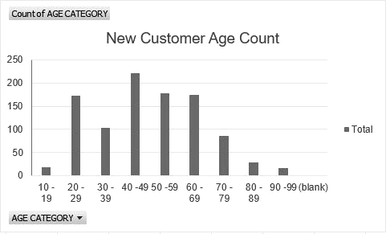
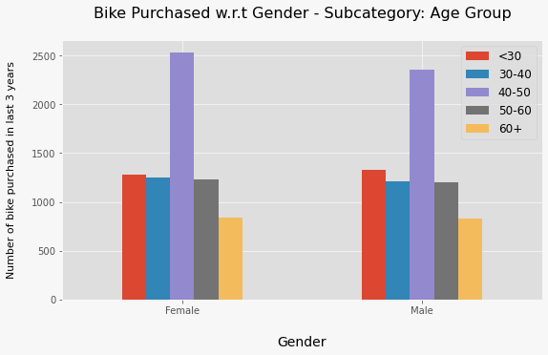
Exploration of data : Age Distribution & Bike Purchases
The majority of new customers are between the ages of 40-49, followed by 50-59 & 60-69.
It is obvious that fewer customers are between the ages of 10-19 and 90-99.
Data show that the 40-50 age group has a high number of bikes purchased in the last three years with a slightly higher female ratio.
Marketing and advertising should target females rather than males as the target audience.

Slide 5
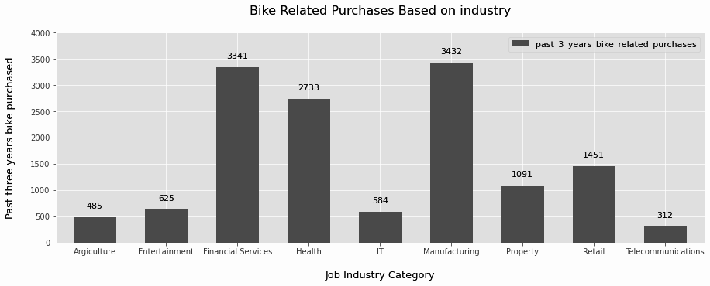
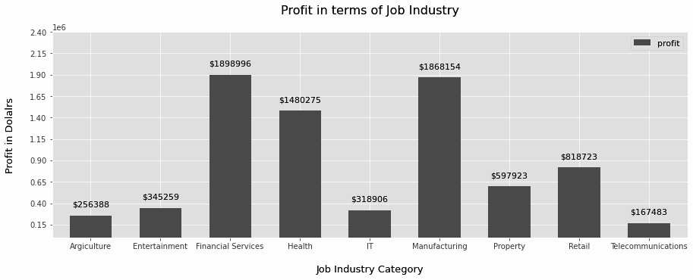
Data Exploration : Job Industry
The top three profit-generating industries are financial services, manufacturing, and health, followed by retail and property.
According to the second chart, Financial Services, Manufacturing, and Health are the industries with the highest profits.

Slide 6
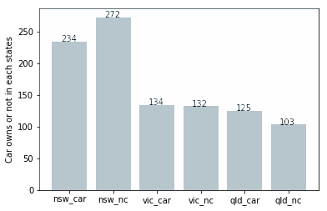
Data Exploration : Number of cars owned
New South Wales could be a potential market opportunity for the company out of the three states.
As the number of people who own vehicles is nearly equal to those who don't own them, New South Wales offers the most potential for value consumers.
In VIC and QLD, there are more car owners than non-owners, but there might be some way to encourage those with cars to purchase bikes.

Slide 7
Model Development
From the new list, target these high-value clients:
Aged between 40 – 50.
Most of the high value customers are female compared to male
Working in Financial Service, Manufacturing and Health.
Who are currently living in New South Wales and Victoria.
CUSTOMER CLASSIFICATION – Targeting High Value Customers

Slide 8
Interpretation
HIGH-VALUE CUSTOMER SUMMARY TABLE
Customer ID | Bike Related Purchases for the last 3 years | Age | Job Industry | Wealth Segment | Owns Cars | State
1842 | 445 | 44 | Financial Services | Mass Customer | No | New South Wales
2001 | 168 | 44 | Manufacturing | Mass Customer | Yes | New South Wales
650 | 486 | 44 | Health | Mass Customer | No | New South Wales
3297 | 234 | 46 | Manufacturing | Mass Customer | No | Victoria
50 | 266 | 41 | Manufacturing | Mass Customer | Yes | New South Wales

Slide 9

THANK YOU

